Slide 1
Classification Model to Predict Fake and Real Job Postings
Joel D’Souza b00079296
Sabbir Alam b00079438

Slide 2
Previous Work
This dataset has been worked on previously before by various people.
Bandar Alghamdi and Fahad Alharby, published in the Journal of Information Security in 2019 achieved their best classification accuracy of 97.41% using Random Forest.
A user called “Madz2000” worked on this dataset on Kaggle reporting a classification accuracy of 97.62% and was uploaded in April of this year using the Multinomial Naive Bayes Classifier algorithm.

Slide 3
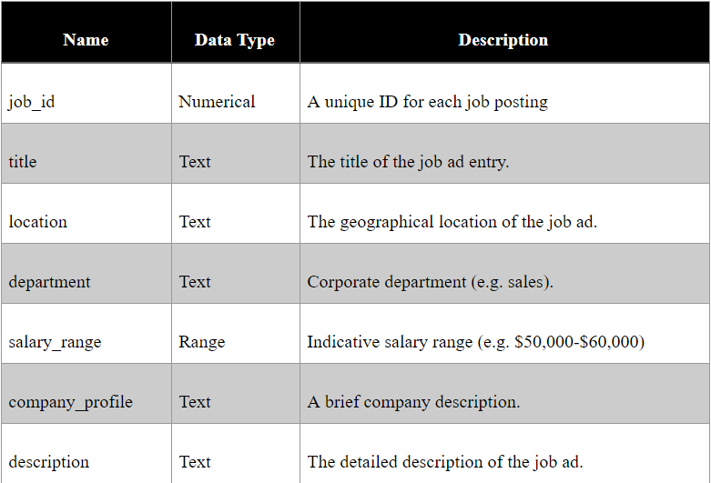
Description of our Dataset

Slide 4
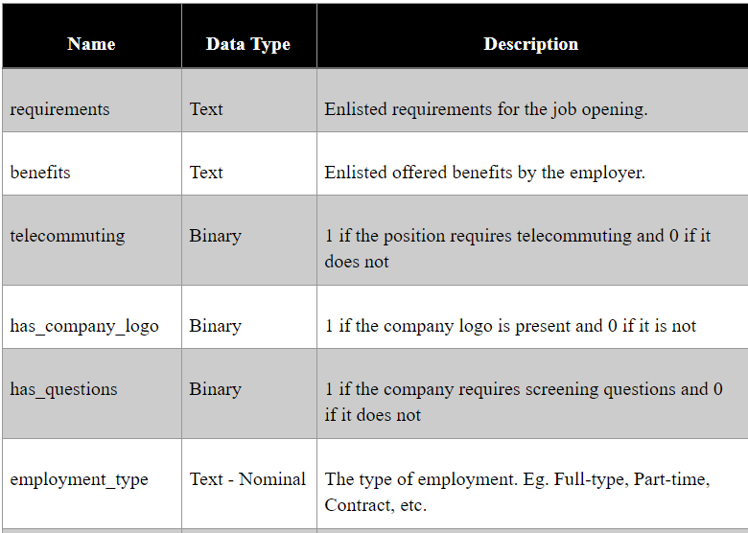

Slide 5
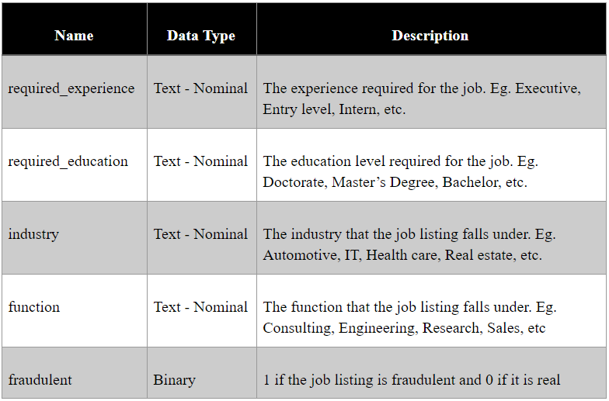

Slide 6
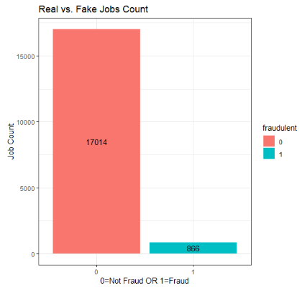
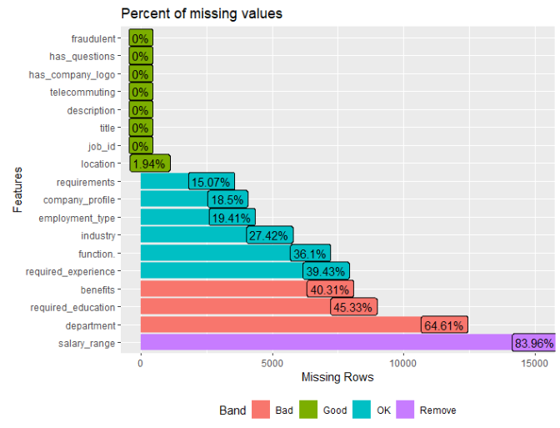
The Dataset Visualized

Slide 7
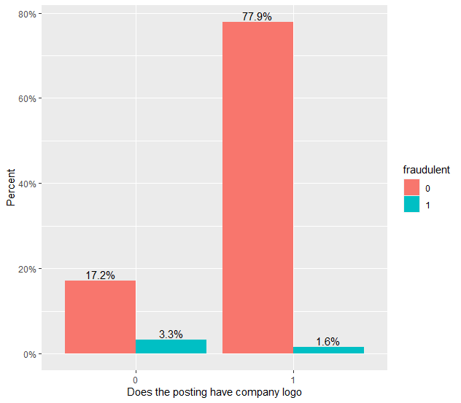
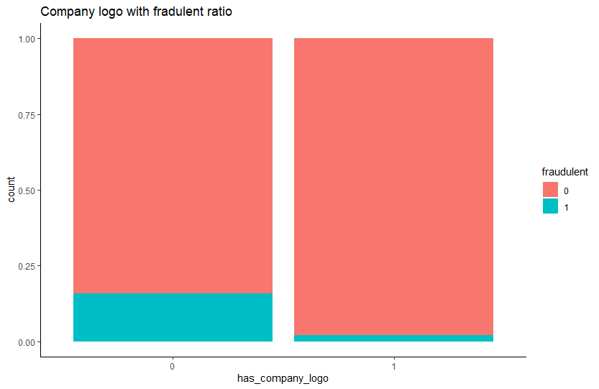
Exploring our Dataset
67% of fake job posting is from companies with no logo.
The proportion of fake to real jobs:
No logo = 16%
Logo = 2%

Slide 8
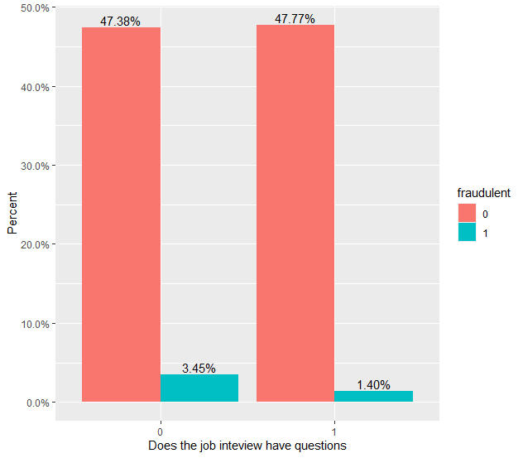
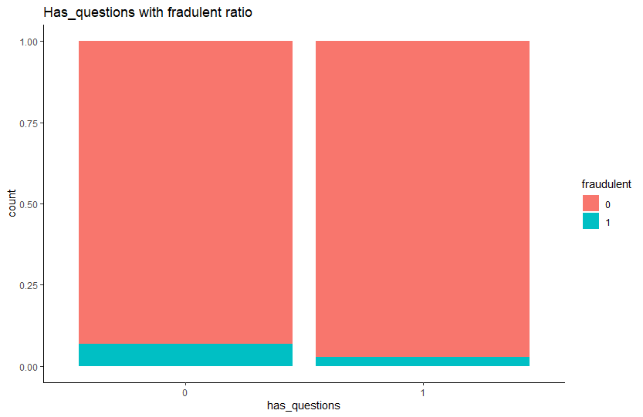
The proportion of fake to real jobs:-
No Question = 6.8%
Question = 2.8%

Slide 9
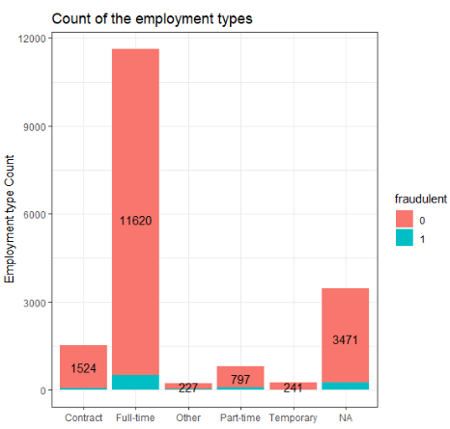
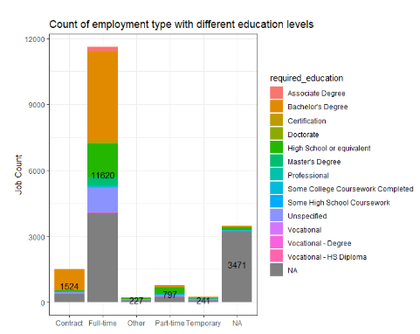
Most of the jobs are full-time positions.
Full-time jobs also has the most number of fraud postings.
Most of the jobs require a Bachelor’s Degree

Slide 10
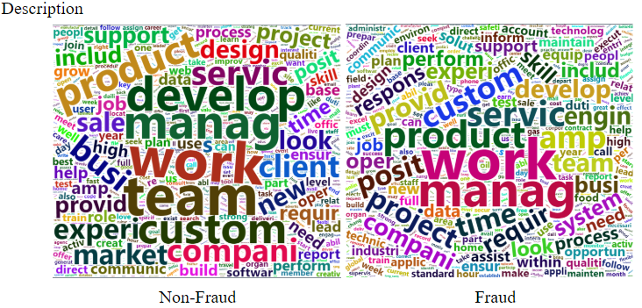
Exploring Word Clouds
Fraud and non-fraud descriptions use similar words like work, team, manage, and develop. However, the ratios of some words used are different, eg team is more often used in non-fraud emails than fraud.
Words like system, train, and look are more frequently used in fraudulent emails

Slide 11
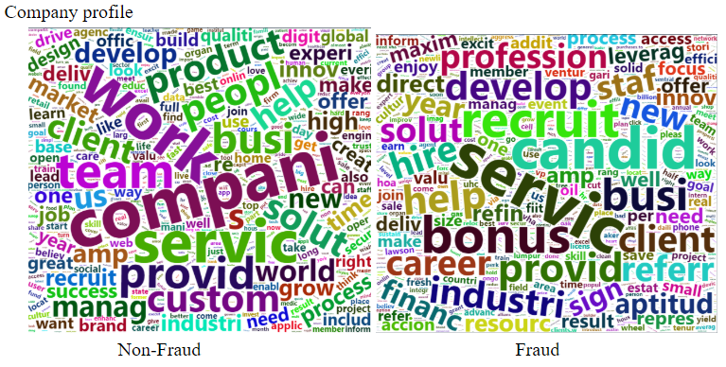
Stemmed words like compani, custom, brand are more frequently used in non-fraud listings.
Stemmed words like candid, recruit, hire, maxim, profession, and bonus could be signifiers that a company’s listing is fake as they are much more frequently used in those types of postings.
Fraudulent emails target job seekers by advertising their company as being more open to recruitment as they used words like “recruit and hire”. On the other hand, real companies were more focused on explaining their company in this section rather than focusing specifically on the job.

Slide 12
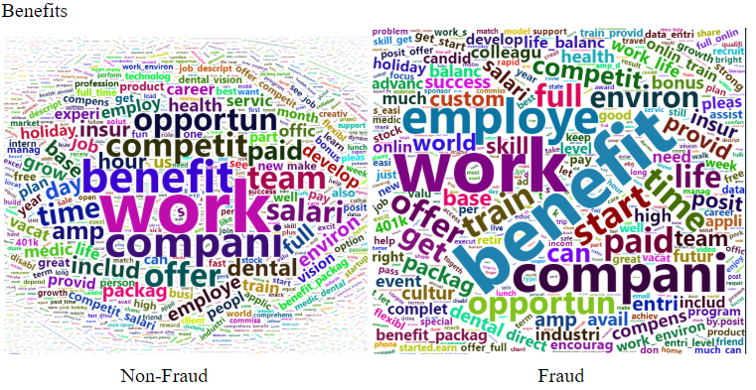
Words like offer, flexible, start, success, work_life, and online_train are much more used in fraud emails
Words like employ, hour, job are more frequently used in real job listings.
We could infer that fraudulent job postings are trying to attract job seekers by using positively toned words which could make it seem like the fake jobs have greater benefits than real jobs which use more of a formal tone to describe the job description.

Slide 13
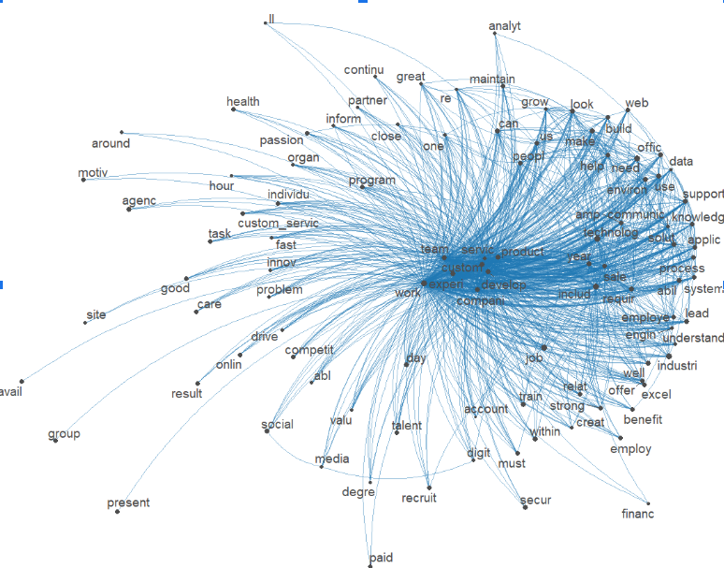
Feature co-occurrence matrix in quanteda package, for the description.
Uses a data frequency matrix to create a matrix of most frequently co-occurring words.
Plotted using textplot_network().
Min freq =850.
Shows us that most words have co-occurred with the middle cluster at least 850 times.

Slide 14
Transforming the data
We split the dataset into 70% train and 30% test by performing a stratified sample with the response (fraudulent).
We cleaned and tokenized the words present within the description, company_profile, requirements, and benefits columns.
We initially tokenized and worked selectively on the description column since it was the only column with several sentences per cell that had no missing values - this gave us the best test classification accuracy.
We then tokenized and worked on all 4 columns, but any combination of them led to a decrease in test accuracy.

Slide 15
Tokenization process
We cleaned the data by removing symbols, numbers, and punctuation.
We then converted all the words into lowercase, removed all the unnecessary stopwords, and stemmed the data to combine all the synonyms together
While making the word clouds we noticed that some special characters such as â, ô and î were predominantly present within the data even after cleaning.
Therefore we had to manually clean these characters out ourselves in MS Excel by replacing them with whitespaces.
Lastly, we tokenized the data through the addition of bi-grams, which led to the creation of two words per token.

Slide 16
Post Tokenization
After tokenizing the description column, we converted it into a Document-Frequency Matrix (DMF).
We then performed TF-IDF (Term Frequency - Inverse Document Frequency) on our data.
The Term Frequency normalizes the frequency of observations while the Inverse Document Frequency penalizes tokens that appear frequently throughout all the documents.
We used Singular Value Decomposition to reduce the dimensions of our DFM making it feasible to efficiently perform data mining techniques on the data, without much loss of information.
We then selectively appended columns from the original dataset to our SVD matrix

Slide 17
Training and testing the model
We created and refined our final test dataset similar to the way we did on our training data.
We performed SVD Projection on the test data, to project it into the training space, such that it would resemble our training data.
We also imputed the missing values present within both our test and training datasets.
The Random Forest gave us our best results:
We utilized the SVD matrix along with the columns function, has_questions, has_company_logo, telecommuting, employment_type, required_experience, and required_education appended to it as factors.
We got a test prediction accuracy of 97.74%.

Slide 18
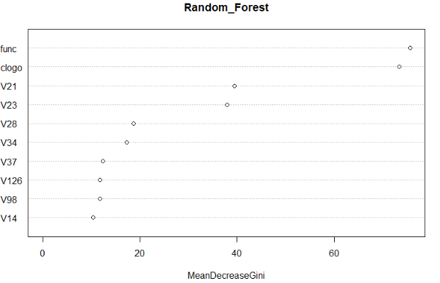
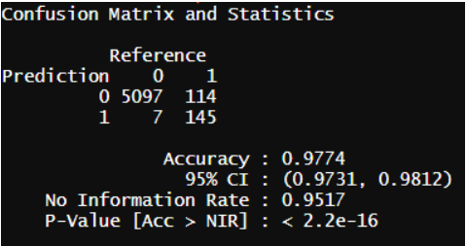
Results
According to this model, the variables function and company_logo were the most important within our prediction model.

Slide 19
Conclusion And Limitations
We can conclude that:
The job description contains significant predictive power in deciding whether a given job posting is fake or not
Function of the job and whether the company has a logo can also help in the decision making capabilities of the model
has_questions did not seem to have as much as an influence as initially we thought it would
Limitations:
Imbalanced data
Only utilized Random Forest for our prediction model, could possibly improve the accuracy with other classification techniques.
Could also include other text analysis techniques such as sentiment analysis to further enhance the model

Slide 20
Thanks!
Does anyone have any questions?

